Slide 1
Peru:
your best investment destination

Slide 2
WHY INVEST IN PERU?
Internationally acknowledged macroeconomic stability
Friendly investment environment
Open trade and market access policy
Notes:
Sin duda la crisis financiera internacional afecta las perspectivas de inversión en el mundo y lleva a los expertos a evaluar los proyectos propuestos con mayor cuidado, lo cual no implica que las empresas puedan dejar de pensar en sus desarrollos de largo plazo.
En este contexto, el Perú destaca como un destino de inversión que vale la pena evaluar. Las razones se pueden resumir en 4 campos básicos:
Estabilidad macroeconómica: la economía peruana presenta excelentes resultados siendo uno de los países mejor preparados para enfrentar la crisis global.
Clima favorable para la inversión: el país ha consolidado uno de los marcos legales más modernos y atractivos para la inversión extranjera responsable.
Acceso a mercados: el Perú ha establecido una amplia red de acuerdos comerciales que le aseguran acceso preferente a prácticamente todos los mercados más dinámicos del mundo.
Desarrollo de infraestructura: el crecimiento exponencial del comercio internacional peruano está generando un sustantivo aumento de la demanda por infraestructura y servicios logísticos. En ese sentido el Estado peruano viene desarrollando obras de infraestructura de importante magnitud en las cual promueve la participación del sector privado. Ello permitirá elevar nuestra competitividad y proyectarnos como una eficiente plataforma productiva y comercial en el Pacífico Sudamericano.
2

Slide 3
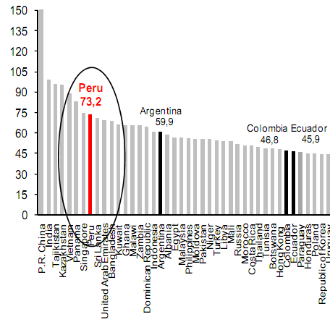
MACROECONOMIC SOUNDNESS
Peru among the fastest growing economies in the world and it will continue leading regional growth
GDP 2002-2010
(Var. accrued %)
Forecast - LATAM: Real GDP 2012-2014
(Average annual % variation)
Source: IMF
Source: Central Reserve Bank of Peru, Ministry of Economy and Finance, IMF.
Notes:
Para el 2009 se proyecta una tasa de crecimiento algo menor a la registrada durante los años previos, pero que se mantendría cercana al 5% anual según el MEF y se proyecta que volvería a incrementarse en los dos años siguientes.
Tales proyecciones se sustentan en 3 factores claves:
Los compromisos de inversión extranjera directa en proyectos en ejecución que en total superan US$ 8 mil millones de dólares al año.
La disposición de las autoridades para ejecutar una política fiscal contra-cíclica, gracias a los sólidos fundamentos presupuestales y al manejo de deuda.
La viabilidad de mantener el ritmo de préstamos para inversión local y de vivienda en vista de la buena condición del sistema bancario.
Con ello, al 2011 se concretaría un ciclo de 10 años consecutivos de crecimiento acelerado.
Estas proyecciones realizadas por el Ministerio de Economía y Finanzas se ven además respaldadas por fuentes externas como la CEPAL (siguiente diapositiva).

Slide 4
MACROECONOMIC SOUNDNESS
ESTABILIDAD MACROECONÓMICA
MACROECONOMIC STABILITY
Economic growth has been driven by rising investment and a dynamic trade exchange ….
Private Investment 2000-2012
(US$ billion)
Balance of Trade 2000-2011
(US$ million)
Source: Central Reserve Bank of Peru and Ministry of Economy and Finance
* Extiamtedy figure
Source: Central Reserve Bank of Peru
Notes:
Tales proyecciones se sustentan en 3 factores claves:
Los compromisos de inversión extranjera directa en proyectos en ejecución que en total superan US$ 8 mil millones de dólares al año.
La disposición de las autoridades para ejecutar una política fiscal contra-cíclica, gracias a los sólidos fundamentos presupuestales y al manejo de deuda.
La viabilidad de mantener el ritmo de préstamos para inversión local y de vivienda en vista de la buena condición del sistema bancario.
Con ello, al 2011 se concretaría un ciclo de 10 años consecutivos de crecimiento acelerado.

Slide 5
MACROECONOMIC SOUNDNESS
ESTABILIDAD MACROECONÓMICA
MACROECONOMIC STABILITY
Peru’s Foreign Direct Investment Stock 2001 -2011
APEC economies Vs. Non Member Economies
US $ 22,019 million
US $
13,019 million
48%
USA
20%
Chile
13%
Canada
7%
Mexico
6%
Singapore
4%
Japan
2%
China
1%
Korea
Source: Proinversion
Notes:
Foreign Direct Investment Stock in Peru 2001- 2011 from APECV Economies Vs Non Member Economies. Source: PROINVERSION

Slide 6
MACROECONOMIC SOUNDNESS
Peru also recorded the lowest annual average inflation rate in Latin America and it keeps a healthy debt level in relation with its international reserves
Forecast - LATAM: Inflation 2012-2014
(Average annual % variation)
Net International Reserves
(US$ Billion)
Source: Central Reserve Bank of Peru and Ministry of Economy and Finance
* Preliminary figure
As of March 7, 2012

Slide 7
MACROECONOMIC SOUNDNESS
The responsible economic policy granted Peru the investment grade and investors’ confidence
Investment grade
Latin America benchmarking
Countries as priority destinations for FDI 2011-2013
(World Ranking among 21 countries)
País | S&P | Fitch | Moody´s
Chile | A+ | A+ | Aa3
Mexico | BBB | BBB | Baa1
Brazil | BBB- | BBB | Baa2
Peru | BBB | BBB | Baa3
Colombia | BBB- | BBB- | Baa3
Bolivia | B+ | B+ | B1
Venezuela | B+ | B+ | B2
Argentina | B | B | B3
Ecuador | B- | B- | Caa2
Dropped 1 position
Improved 5 positions
Without changes
Source: Standard & Poor`s, Fitch Ratings and Moody´s.
Updated to March 2, 2012
Source: UNCTAD – WIR 2011
Notes:
7
En cuanto a la posición externa…
La responsable política económica, que ha mantenido continuidad a través de la sucesión de gobiernos democráticos, ha permitido acumular reservas internacionales que cubren en exceso la deuda externa, fortalecer el sistema financiero (muy baja morosidad), mantener un importante superávit fiscal y reducir el ratio deuda-PBI, lo cual coloca al Perú en mejores condiciones que muchos otros países en el mundo para afrontar el actual escenario de crisis internacional.
Perú ha venido registrando superávit presupuestales por varios años y el nivel de su deuda pública es bajo. De hecho, Perú es uno de los pocos países donde las reservas internacionales del Banco Central (US$ 31 mil millones o 26% del PBI) exceden el total de la deuda pública interna y externa (US$ 30 mil millones).
Finalmente, cabe anotar que ante un escenario de mayor volatilidad, donde aumenta la percepción del riesgo sobre las economías emergentes, el Perú sigue manteniendo un nivel de riesgo país por debajo del promedio regional y ha podido alcanzar (desde julio de 2008) que 3 agencia clasificadoras de riesgo (Standard & Poors, Fitch Ratings y la agencia canadiense Dominion Bond Rating Service) lo posicionen como país con grado de inversión.
En cuanto a la posición externa…
La responsable política económica, que ha mantenido continuidad a través de la sucesión de gobiernos democráticos, ha permitido acumular reservas internacionales que cubren en exceso la deuda externa, fortalecer el sistema financiero (muy baja morosidad), mantener un importante superávit fiscal y reducir el ratio deuda-PBI, lo cual coloca al Perú en mejores condiciones que muchos otros países en el mundo para afrontar el actual escenario de crisis internacional.
Perú ha venido registrando superávit presupuestales por varios años y el nivel de su deuda pública es bajo. De hecho, Perú es uno de los pocos países donde las reservas internacionales del Banco Central (US$ 31 mil millones o 26% del PBI) exceden el total de la deuda pública interna y externa (US$ 30 mil millones).
Finalmente, cabe anotar que ante un escenario de mayor volatilidad, donde aumenta la percepción del riesgo sobre las economías emergentes, el Perú sigue manteniendo un nivel de riesgo país por debajo del promedio regional y ha podido alcanzar (desde julio de 2008) que 3 agencia clasificadoras de riesgo (Standard & Poors, Fitch Ratings y la agencia canadiense Dominion Bond Rating Service) lo posicionen como país con grado de inversión.

Slide 8
MACROECONOMIC SOUNDNESS
Additionally, has supported a massive growth of consumption markets
2000
2010
Source: Ministry of Economy and Finance

Slide 9
FRIENDLY INVESTMENT ENVIRONMENT
Peru offers a favorable legal framework for foreign investment …
  Non discriminatory treatment: Foreign investors receive the same treatment as local investors.
  Unrestrictive access to most economic sectors *.
  Free transfer of capital.
  Free competition.
  Guarantee for Private Property.
  Freedom to purchase stocks from locals.
  Freedom to access internal and external credit.
  Freedom to pay royalties.
  Network of investments agreements and member of ICSID and MIGA.
  Peru participates in the Investment Committee of the Organisation for Economic Co-operation and Development (OECD) – It promotes the implementation of the Guidelines for Multinational Enterprises.
*Investments that require authorization: Located within 50 km in the frontier line and those destined to arms, ammunitions and explosive. Likewise, a principal local partner for investments in maritime cabotage as well as in air transport is required.

Slide 10
FRIENDLY INVESTMENT ENVIRONMENT
Special Regimes: Legal Stability Agreements
Regime whereby the Peruvian Government guarantees:
INVESTORS
  Stability of the regulations regarding non discriminatory treatment.
  Stability of the income tax regime applicable to dividends.
  Stability to use freely the most favorable exchange rate available in the market.
  Stability of the free availability and remittance of foreign currency, dividends and royalties regime.
RECEIVING COMPANY
  Stability of the recruitment regimes.
  Stability of the regimes for the promotion of exports.
  Stability of the Income Tax Regime
Requirement: Minimum investment of US$ 5 million in any economic sectors. US$ 10 million for hydrocarbon and mining sectors.
Validity: 10 years. Concessions: Term according to the contracts life (Max. 60 years).

Slide 11
FRIENDLY INVESTMENT ENVIRONMENT
Special Regime: VAT Anticipated Recovery.
Regime whereby the Peruvian Government grants the following benefits:
  Granting the return of the Value Added Tax during the pre-productive stage of the project (minimum 2-year term).
  Applicable to all economic sectors
  For agricultural activity it is not necessary to meet a minimum investment amount. For other activities the minimum investment amount is US$ 5 million.
  The project can be divided into stages, phases or similar.

Slide 12
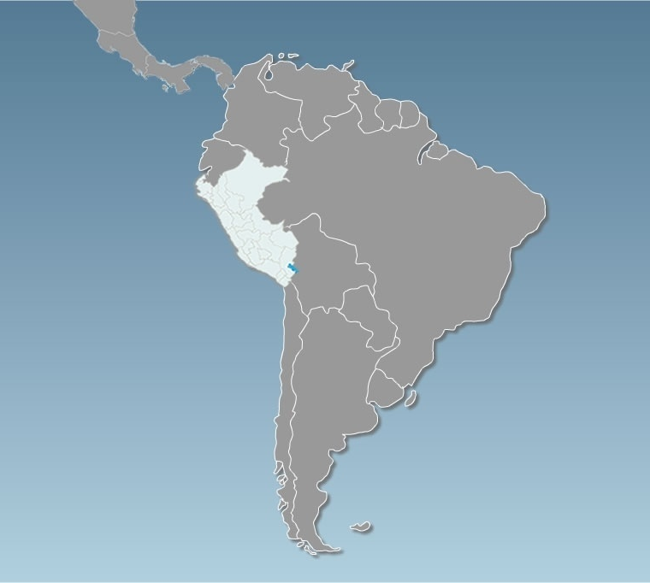
FRIENDLY INVESTMENT ENVIRONMENT
Continuous effort to facilitate the establishment and operation of business
Peru ranks second in the region in the improvement of business regulations.
Venezuela
177
Guyana
Doing Business 2012
Colombia
114
42
Surinam
.
158
Position | Country
1 | Chile
2 | Peru
3 | Colombia
4 | Uruguay
5 | Paraguay
Ecuador
130
Brazil
Peru
126
41
Bolivia
Paraguay
153
102
Chile
Uruguay
39
90
Argentina
113
Notes:
12

Slide 13
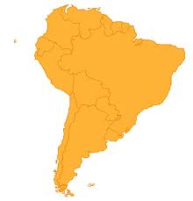
FRIENDLY INVESTMENT ENVIRONMENT
Recognition of a favorable investment environment
130
FORBES MAGAZINE
62
Peru ranks second in the list of the best places for doing business in Latin America
114
73
Position | Country
1 | Chile
2 | Peru
3 | Uruguay
4 | Colombia
5 | Brazil
6 | Paraguay
7 | Argentina
8 | Ecuador
9 | Bolivia
10 | Venezuela
42
123
86
24
61
95
Source: Annual ranking of top economies for business 2011, Forbes magazine
Notes:
13

Slide 14
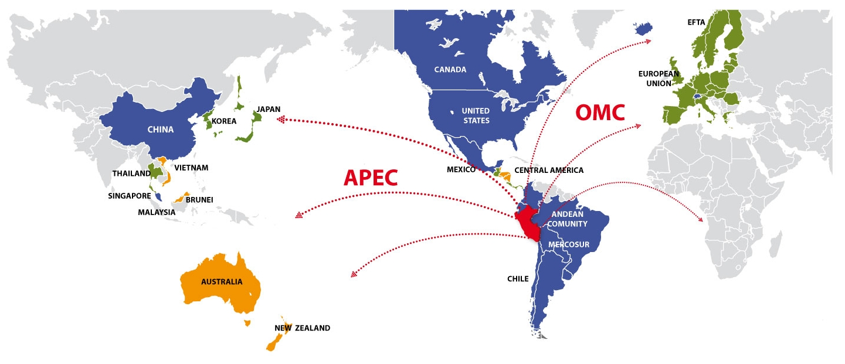
OPEN TRADE AND MARKET ACCESS POLICY
Working to become a globalized economy,
with preferential access to the world’s largest markets
These countries stand for enlarged market of over 4 billion people with a joint GDP over US$ 56 billion
96% of Peruvian exports
Agreements in force
Agreements to become effective
Agreements under negotiations
Notes:
14
Un tercer factor de importancia a tomar en cuenta para evaluar al Perú con destino de inversiones es su activa política de integración comercial con el mundo.
A través de diversos esquemas de integración, se ha logrado el acceso a importantes mercados ampliados, hacia los cuales podrá acceder el inversionista que se establezca en el país. Ejemplo de ello son los Tratados de Libre Comercio suscritos con Estados Unidos, Canadá, Singapur y China, y el Acuerdo con Tailandia. Destacar que el tratado con Estados Unidos entró en plena vigencia el 1 de febrero de este año y se negocian otros tratados con la Unión Europea, EFTA y Corea.
El Perú es además miembro de la Comunidad Andina de Naciones y mantiene también preferencias arancelarias con la mayoría de los países latinoamericanos como México, Chile, Mercosur, etc.
Es meta del Perú convertirse en el principal hub de negocios o plataforma exportadora en la región del Pacífico Sudamericano.

Slide 15
Peru Investment Opportunities

Slide 16
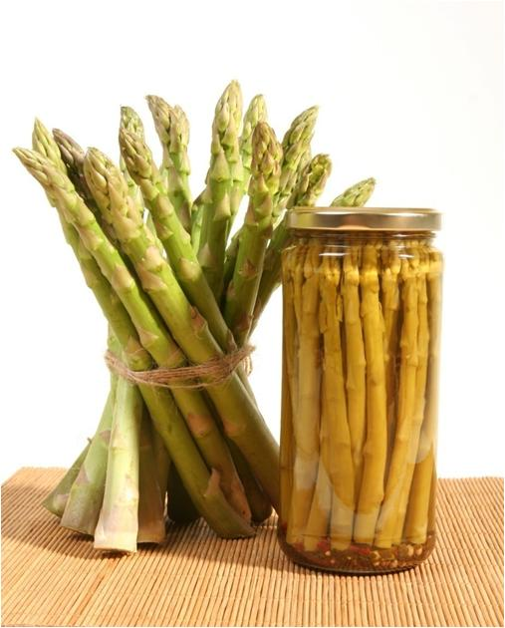
AGRIBUSINESS SECTOR
  Natural greenhouse.
  The best agricultural yields in the world 2010.
    Sugar cane (2nd)
    Asparagus and olives (3rd)
    Artichokes (4th)
    Grapes (6th)
    Avocado (11th)
  Seasonal windows in the most important markets.
  Projections expect that the 90,000 ha currently used for agro exports to double as consequence of large irrigation projects in portfolio.
  Over US$ 4,400 million in exports of fresh and processed products to over 156 countries.
  Organic and Natural Products with high export value.
Notes:
16
16
The dry tropic with vertical solar radiation generates an artificial greenhouse with adequate lighting and temperature differences between day and night.
Best agricultural yields in the world:
Sugar cane (1st),
Asparagus, olives and artichokes (3rd),
Grapes (5th)
Access to “seasonal windows” in the most important markets, with premium on prices.
Irrigation projects will permit to expand the 90,000 ha used for agroexports.
Majes Siguas: 38,000 ha
Olmos: 35,000 ha
Chavimochic: 20,000 ha
Over US$ 2.5 billion in fresh and processed products exports to over 113 countries.
First asparagus , organic coffee and organic plantain exporting country in the world.
Products with high export potential: Andean cereals (kiwicha, quinoa and tarwi), exotic fruits (custard apple, aguaje and camu camu), berries, avocado, among others.
Potential of coastal lands for agroexports:
Tumbes: 30,000/ cereal-growing crops.
Piura: 50,000/ ethanol
Lambayeque:38,000/ Private initiative underway.
La Libertad: 20,000/Chavimochic for exports
8,000/Exports
10,000
Arequipa: 38,000/Majes II
8,000/Majes I
Total: 202,000

Slide 17
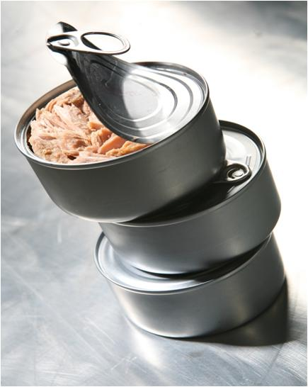
FISHERIES SECTOR
  Extensive fishing coast (3,080 km) and “water mirrors” that offer adequate conditions for the development of marine and continental aquaculture.
  First producer of fishmeal and fish oil in the world.
  Distribution of Peruvian fisheries products to over 100 countries.
  Trend towards product diversification.
Notes:
17
17
Extensive fishing coast (3,080 km) with abundant phytoplankton and zooplankton and confluence of marine currents: Humboldt and El Niño; and “water mirrors” that offer adequate conditions for the development of marine and continental aquaculture.
Second producer and first exporting country of fishmeal and fish oil in the world.
Distribution of Peruvian fisheries products to over 100 countries in five continents, being the most important China, Germany and Japan.
Trend towards product diversification
Continental aquaculture: Trout, Tilapia, Shrimp, Giant squid, etc.
Marine aquaculture: Scallops, King prawn, etc.

Slide 18
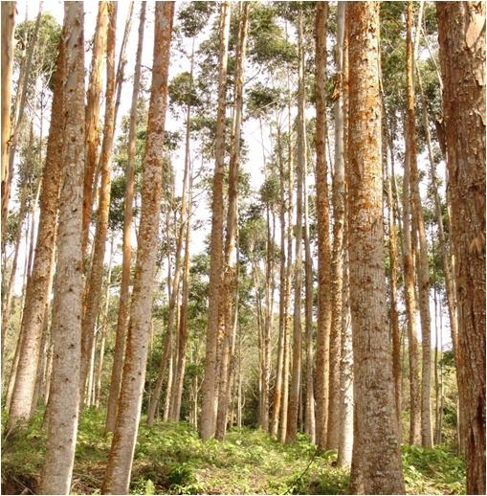
FORESTRY SECTOR
    Presence of great biological diversity and highly valued timber.
    Development of hard tropical timber in the forest and soft timber in the highlands of the country.
    2nd country with the largest natural forest area in Latin America.
    78,8 million ha of natural forests, 10 million ha for reforestation and other areas for afforestation (plantations).
    Investment opportunities in industrial timber complexes.
Notes:
18
18
Presence of great biological diversity and highly valued timber.
Development of hard tropical timber in the forest and soft timber in the highlands of the country.
2nd country with the largest natural forest area in Latin America, after Brazil.
78,8 million ha of natural forests, 10 million ha for reforestation and other areas for afforestation (plantations).
Forestry products exports grew to US$ 296 million in 2009; 76% were timber product exports and 24% non-timber product exports.
Investment opportunities in industrial timber complexes.

Slide 19
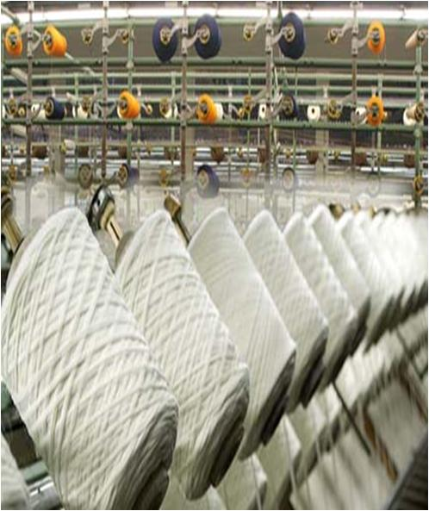
TEXTILE SECTOR
  Recognized quality of Peruvian pima cotton, considered as one of the most demanded and finest fiber in the world.
  First world producer of the finest South American camelids fibers: alpaca and vicuna.
  Long textile tradition favors workforce professionalization and training.
  International recognition as “full package” supplier of the best brands in the world.
  Sound trend towards textile and apparel exports growth. Annual average growth of 10% in the last 10 years. Reaching its maximum level in 2008: US$ 2,000 million.
Notes:
Use of Pima cotton in the apparel sector is a strategic differentiator due to its extra-long and soft fiber, considered one of the most demanded and finest fiber in the world.
First world producer of the finest South American camelids fibers: alpaca and vicuna, superior to Kashmir fiber.
Long textile tradition, favors workforce professionalization and training for agricultural activities and design and apparel making processes.
International recognition as “full package” supplier of the best brands in the world in cotton knitted fabrics.
Solid trend towards exports growth, reaching its maximum level in 2008: US$ 2 billion.
Brands attended by Peruvian industries:
Abercrombie & Fitch; Izod Ara Intersales; JC Penny; Armani Exchange;
Nassino Dutti; Calvin Klein; Nautica Donna Karan Inc.; New Balance;
DKNY; Lacoste; Duck Head; Appared Co.; Kenneth Cole; Eddie Bauer;
Levy Strauss and Co.; Guess; Oakley; Inditex/Zara; Palacio de Hierro;
Polo Ralph Lauren; Ragman; Perry Ellis; International Reebok;
The Gymboree Corp.; Vanity Fair; Tommy Hilfiger; Saks Inc.

Slide 20
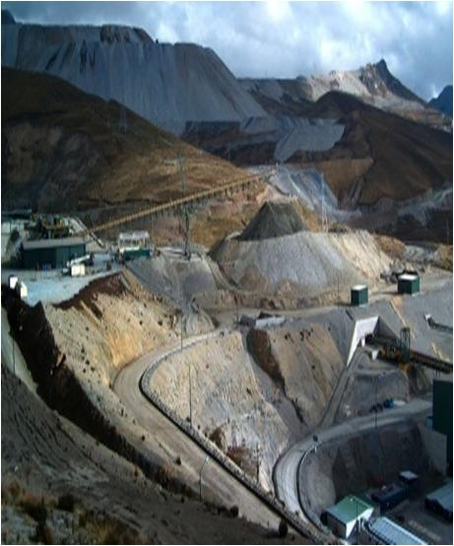
MINING SECTOR
MINING SECTOR
  Polymetallic country, second in copper, third in zinc and first in silver reserves worldwide.
  13.61 % of the territory is subject to mining concessions, and only 1.09 % is used for mining exploration and exploitation.
  Worldwide: second producer of copper and 3rd of silver, tin and zinc. In Latin America: 1st gold, zinc, tin and lead producer; and 2nd copper, silver and molybdenum producer.
  In 2011, mining exports grew by 23.25% despite having registered a drop in the volume of production of most minerals.
  Peru is one of the few countries with non-metallic mineral deposits, such as mercury, selenium and cadmium.
Notes:
Polymetallic country, third in gold, silver, copper and zinc reserves.
Only 20% of territory with mining potential has been explored and 6% is currently being exploited.
First silver world producer. And in Latin America:
1st gold, zinc, silver, tin and lead producer.
2nd copper and molybdenum producer.
Between years 1999 and 2009 investment in the sector exceeded US$ 14.4 billion and the investment projects announced for the following years are likely to reach US$ 37 billion.
Practically all large mining companies of the world have operations in Peru.
Peru is one of the few countries with non-metallic minerals deposits: diatomite, bentonite and borates.

Slide 21
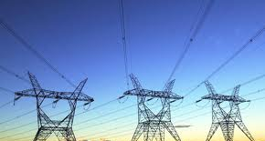
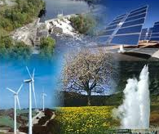
ENERGY SECTOR
Great energy potential: Wide availability of water and natural gas resources have made possible to deal with the increasing electric demand of the country (2011 growth rates: 8.3%)
Resources to be discovered and exploited: There are other renewable energy sources to explore, such as solar, wind, biomass and geothermal energy sources.
Energy matrix mostly based on renewable sources (about 57% of the electric demand is generated with hydro-electric sources, 38% with natural gas, 2% with coal and 3% with other sources)
In the last five years, the energy production has increased in 40.38% due mainly to the thermoelectric generation growth with an annual average rate of 16%.
Main economic groups that comprise 62% of energy production in Peru are Endesa, Globeleq, Suez and Duke Energy.

Slide 22
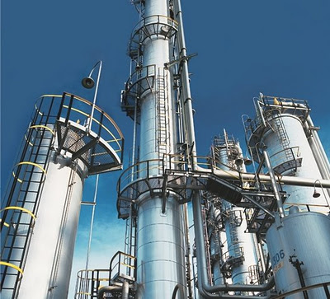
PETROCHEMICAL SECTOR
  In 2011, the natural gas production reached 401, 169 million cubic feet, boosted by the greater demand of power generation plants and the major consumption of vehicular, domestic and commercial natural gas.
  Peru is the only sustainable source of natural gas in the South American Pacific rim.
  Peru has oil fields which have not been explored yet (26.60 million of ha), becoming therefore, a potential petrochemical pole.
  Petrochemical industry merges with natural gas production and other hydrocarbons adding an added value using the «Upstream Integration» Development Strategy.
  Fertilizers, plastics and detergents are some of the products made by petrochemical industry.
  US$ 17,150 million from private investment will be assigned to the construction of two ammonia plants, two ammonium nitrate plants, one urea plant and one ethylene plant to be placed in the departments of Ica and Moquegua.
Notes:
22
22

Slide 23
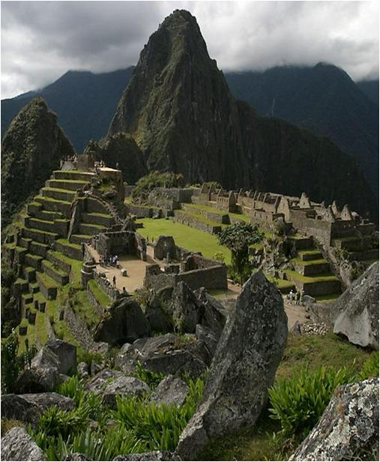
TOURIST SECTOR
  Important cultural destination to Inca and Pre-Inca cultures archaeological sites.
    Machu Picchu is one of the new 7 Wonders Worldwide.
  Diversity of natural landscapes.
  Birds and orchids watchers ‘ paradise.
  Lima is the gastronomic capital of Latin America.
  Significant investment from hotels of international recognition.
  Investment opportunities in the 8 prioritized tourist destinations: North beaches, Amazonas River, Amazonas-Kuelap, Moche Route, Lima, Nazca-Paracas, Valle del Colca and Puno-Titicaca Lake.
Notes:
23
23

Slide 24
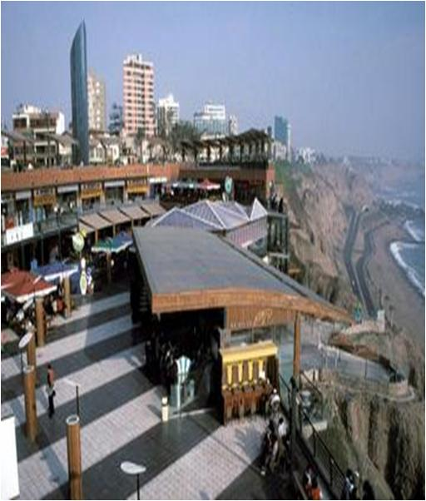
REAL ESTATE SECTOR
Annual average growth of construction GDP for 2010 is 18.0%.
Housing deficit affects 25% of population.
  Lima holds 25% of total deficit, and 48% of quantitative deficit.
    There are several programs for housing financing, based on households socio-economic conditions and income level: Techo propio, Fondo Mi Vivienda and commercial banking.
    Mortgage credits grew an average of 17% in the last 4 years (2008 -2011).

Slide 25


TECHNOLOGICAL SERVICES
The lowest labor cost per operator in Latin America (US$ 270) is a major determinant in an industry with 60% of the costs related to human resources.
The industry currently represents 15.574 positions, and it generates 29.665 direct jobs, and exports have tripled in 5 years.
The software sector has present in the last 6 years an annual average growth rate of 15%, and it generates 6,000 direct jobs highly qualified.
The contact centers services exports, data processing, application of IT program and similar are exempt from VAT.
Availability of technological resources and low real estate costs.
The implementation of the Data Protection Law (approved in 2011) will strengthen the position of companies, making possible to establish more trading links.

Slide 26
PROJECTS PORTFOLIO

Slide 27
PRIVATE INVESTMENT PROMOTION PROCESS – SHORT TERM 2012 – 2013
SECTOR | N° PROJECTS | ESTIMATED INVESTMENT
Land transport | 2 | 3,867.1
Railways | 1 | 3,000.0
Energy (Electricity) | 5 | 1,145.0
Hydrocarbons | 3 | 790.0
Telecommunication | 3 | 763.4
Agriculture | 2 | 503.0
Airport | 1 | 420.0
Ports and Navigability | 2 | 159.8
Sanitation | 1 | 35.6
Tourism | 1 | 10.6
Mining | 2 | ----
Capital Markets | 1 | ----
Culture | 1 | ----
Total | 25 | 10,694.5

Slide 28
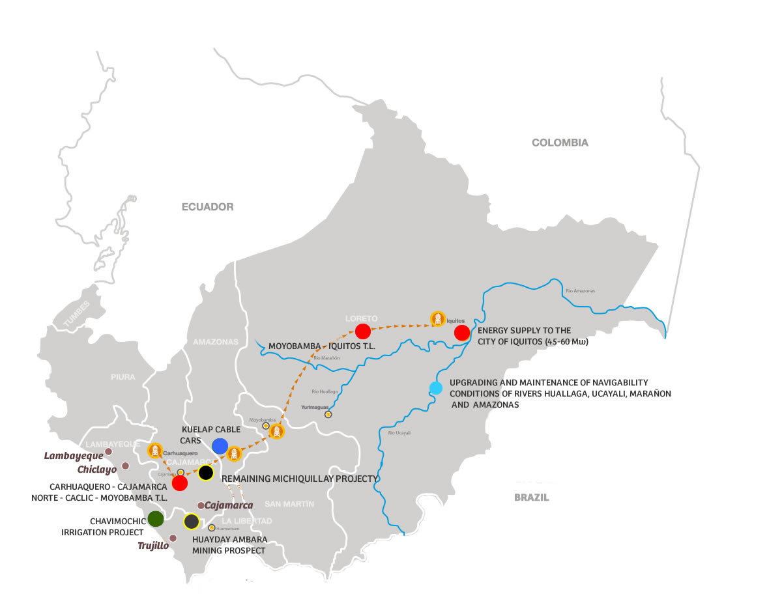
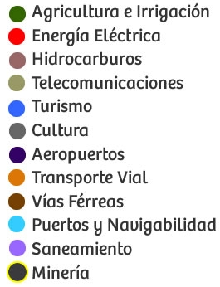
PROJECTS PORTFOLIO 2012-2013
NORTHERN MACRO-REGION
Agriculture
Electricity
Hydrocarbons
Telecommunications
Tourism
Culture
Airport
Land trasnport
Railroad
Port
Sanitation
Mining

Slide 29
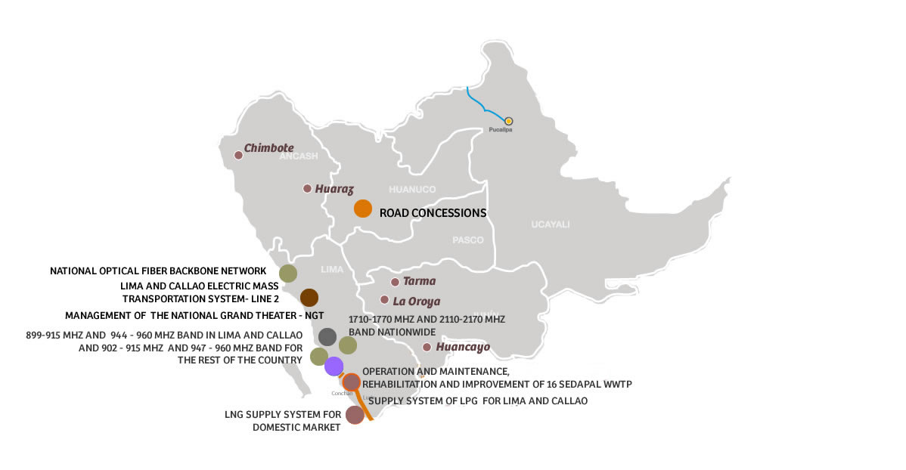
PROJECTS PORTFOLIO 2012-2013
CENTRAL MACRO-REGION
Agriculture
Electricity
Hydrocarbons
Telecommunications
Tourism
Culture
Airport
Land trasnport
Railroad
Port
Sanitation
Mining

Slide 30
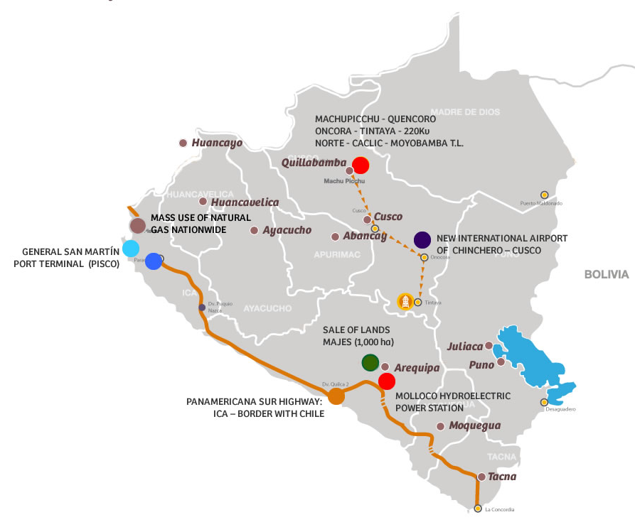
PROJECTS PORTFOLIO 2012-2013
SOUTHERN MACRO-REGION
Agriculture
Electricity
Hydrocarbons
Telecommunications
Tourism
Culture
Airport
Land trasnport
Railroad
Port
Sanitation
Mining

Slide 31
LAND TRANSPORT AND RAILROAD PROJECTS PORTFOLIO
PROJECT | CURRENT STATUS | ESTIMATED INVESTMENT US$ MILLION ( VAT not included) | PLANNED AWARD DATE
1. Panamericana Sur highway: Ica – border with Chile: Section Dt. Quilca – Dt. Arequipa; Dt. Matarani – Dt. Moquegua; Dt. Ilo – Tacna – La Concordia | Call for tender was made | 67.1 | III QT 2012
2. Road concession | To be called | 3,800.0 | From 2013
3. Lima and Callao electric mass transportation system- Line 2 | To be called | 3,000.0 | IV QT 2013

Slide 32
ENERGY PROJECTS PORTFOLIO
ELECTRICITY
PROJECT | CURRENT STATUS | ESTIMATED INVESTMENT US$ MILLION (VAT not included) | PLANNED AWARD DATE
TRANSMISSION LINES
1. 220 kW Cajamarca Norte - Carhuaquero Transmission Line. | Call for tender was made | 130.0 | III QT 2012
2. 220 kW Moyobamba – Yurimaguas - Nauta-Iquitos Transmission Line | Call for tender was made | 345.0 | IV QT 2012
3. 220 kW Machu Picchu – Quencoro – Onocora -Tintaya Transmission Line | Call for tender was made | 70.0 | IV QT 2012
HYDROELECTRIC POWER STATIONS
4. Molloco hydroelectric power station | Call for tender was made | 600.0 | IV QT 2012
THERMAL POWER STATIONS
5. Energy supply to the city of Iquitos (70 Mw) | To be called | To be defined | IV QT 2012

Slide 33
ENERGY PROJECTS PORTFOLIO
HYDROCARBONS
PROJECT | CURRENT STATUS | ESTIMATED INVESTMENT US$ MILLION (VAT not included) | PLANNED AWARD DATE
1. Supply System of LPG for Lima and Callao | Call for tender was made | 90 | IV QT 2012
2. Mass use of natural gas nationwide | To be called | 300 | IV QT 2012
3. Supply system of LNG for domestic market | To be called | 400 | IV QT 2012

Slide 34
AIRPORT AND PORT PROJECTS PORTFOLIO
PROJECT | CURRENT STATUS | ESTIMATED INVESTMENT US$ MILLION ( VAT not included) | PLANNED AWARD DATE
1. New international airport of Chinchero –Cusco | The call for tender was made | 420.0 | IV QT 2013
2. General San Martin port terminal | The called for tender was made | 101.4 | I QT 2013
3. Upgrading and maintenance of navigability conditions of Rivers Huallaga, Ucayali, Marañon and Amazonas | To be called | 58.4 | II QT 2013

Slide 35
TELECOMMUNICATION PROJECTS PORTFOLIO
PROJECT | CURRENT STATUS | ESTIMATED INVESTMENT US$ MILLION (VAT not included) | PLANNED AWARD DATE
1. 899-915 MHz and 944 - 960 MHz Bands in Lima and Callao; and, 902 - 915 MHz and 947 - 960 MHz Bands for the rest of the country. | The call for tender was made | 343.4 | III QT 2012
2. 1710 – 1770 MHz and 2110 – 2170 MHz Band Nationwide | The call for tender was made | To be defined | IV QT 2012
3. National optical fiber backbone network | To be called | 420.0 * | IV QT 2013
* VAT included

Slide 36
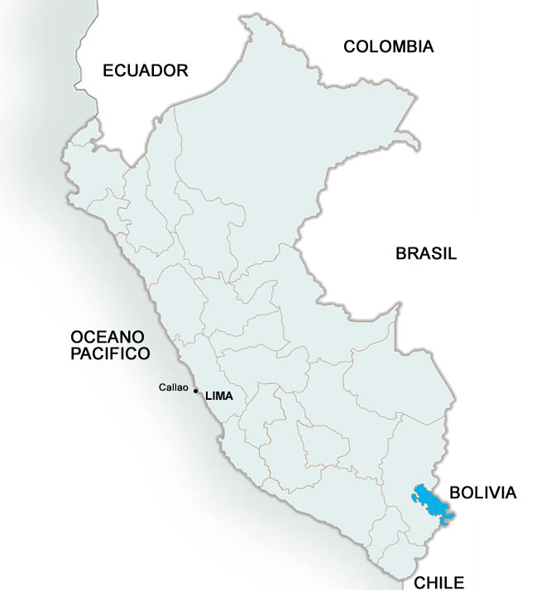
AGRICULTURE AND IRRIGATION PROJECTS PORTFOLIO
PROJECTS | CURRENT STATUS | ESTIMATED INVESTMENT US$ MILLION (VAT not included) | PLANNED AWARD DATE
1. Chavimochic irrigation project | To be called | 498.8 | II QT 2013
2. Majes Siguas project Land Sale in Majes (1,000 ha) | Call for tender was made | 4.2 | II QT 2013
La Libertad
1
BRAZIL
PACIFIC
OCEAN
2
Arequipa
Notes:
36
36

Slide 37
SANITATION PROJECTS PORTFOLIO
PROJECT | CURRENT STATUS | ESTIMATED INVESTMENT US $ MILLION (VAT not included) | PLANNED AWARD DATE
Operation and maintenance, rehabilitation and improvement of 16 SEDAPAL WWTP | Private Initiative Under process | 35.6 | II QT 2013
BRAZIL
PACIFIC OCEAN
1

Slide 38
TOURIST AND CULTURE PROJECT PORTFOLIO
PROJECT | CURRENT STATUS | ESTIMATED INVESTMENT US$ MILLION ( VAT included) | ESTIMATED AWARD DATE
1.- Kuelap Cable car | To be called | 10.6 | II QT 2013
2. Management of the National Grand Theater | To be called | 95.0* | IV QT 2012
* Estimated costs of operation and maintenance for 20 years.

Slide 39
MINING PROJECTS PORTFOLIO
PROJECT | CURRENT STATUS | ESTIMATED INVESTMENT US$ MILLION | PLANNED AWARD DATE
1. Mining prospects of Huayday Ambara | To be called | To be defined | IV QT 2012
2. Concession of Remaining Michiquillay Project | To be called | To be defined | II QT 2013
2
Cajamarca
1
BRAZIL
La Libertad
PACIFIC
OCEAN

Slide 40
www.proinversion.gob.pe
contact@proinversion.gob.pe
Notes:
40

